Slide 1
Single-cell Expression Profiling in Type 1 Diabetes
Louis Gioia
Su Lab
5/4/2018

Slide 2
Notes:
improper blood glucose regulation leading to hyperglycemia
role of insulin discovered in 1920s
type 1 diabetes characterized as autoimmune disease in 1970s
type 1 diabetes affects 1 million people in the US alone and represents 10% of all diabetes cases

Slide 3
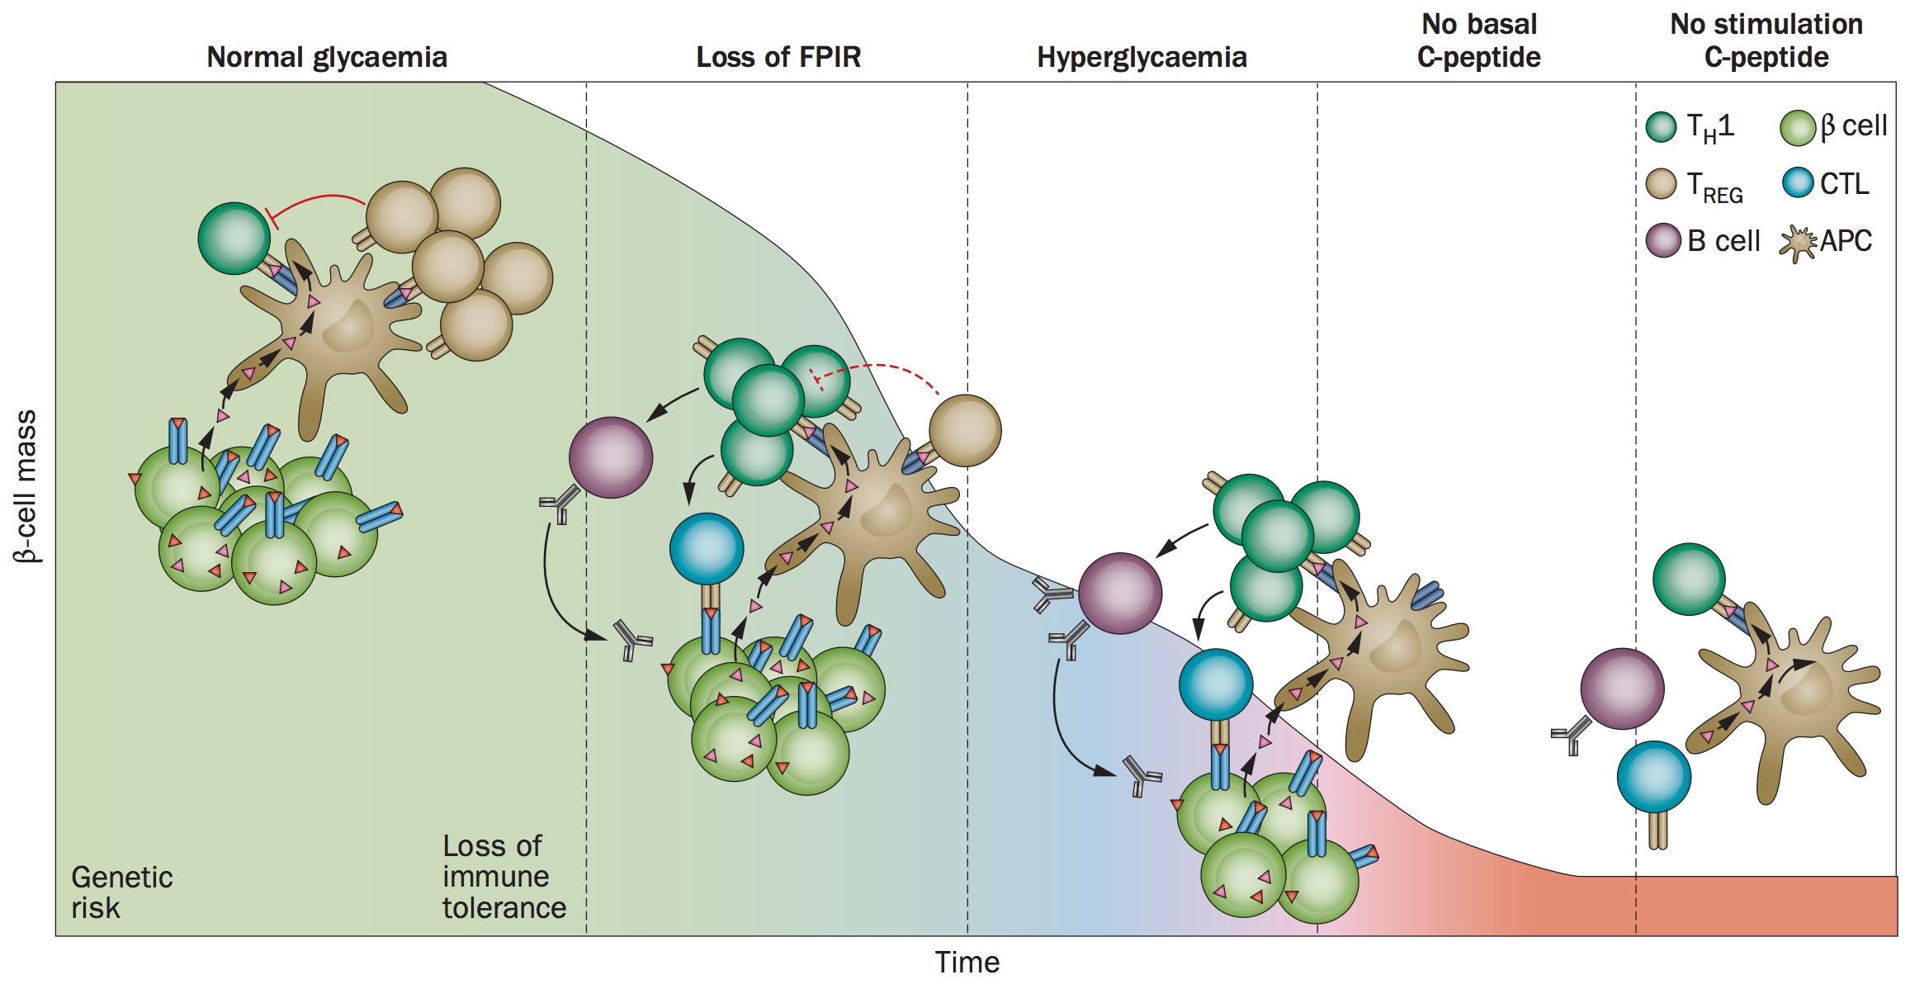
Type 1 diabetes
Roep & Tree Nature Reviews Endocrinology (2014)
Notes:
Natural history of the immunopathogenesis of T1DM. An immune balance is established after birth in which islet autoreactive T cells are kept in check by immune regulation, preventing these cells from becoming active. If this state of immune tolerance is challenged by as yet unidentified factors, the immune system can become imbalanced. Regulatory T cells no longer suffice to control islet autoreactive T cells, which leads to loss of tolerance and activation of B cells (to produce islet autoantibodies) and effector T cells. With declining functional β‑cell mass, the response to increased blood levels of glucose becomes impaired (loss of FPIR). At this stage, regulatory T cells are believed to delay the β‑cell destruction process and clinical manifestation of T1DM (hyperglycaemia), but with time, immune regulation is outweighed by islet autoreactivity. Following clinical onset of T1DM, β‑cell function deteriorates progressively, ultimately leading to loss in glucose-stimulated β‑cell function. It is unclear whether the chronic progressive disease progression pattern as depicted here can have relapsing/remitting variants. The small triangles represent islet autoantigens. Abbreviations: APC, antigenpresenting cell; CTL, cytotoxic T cell; FPIR, first-phase insulin response; TH1, T helper 1; TREG, regulatory T cell; T1DM, type 1 diabetes mellitus

Slide 4
Cd4+ T-cell subsets

Slide 5
Cd4+ T-cell subsets

Slide 6
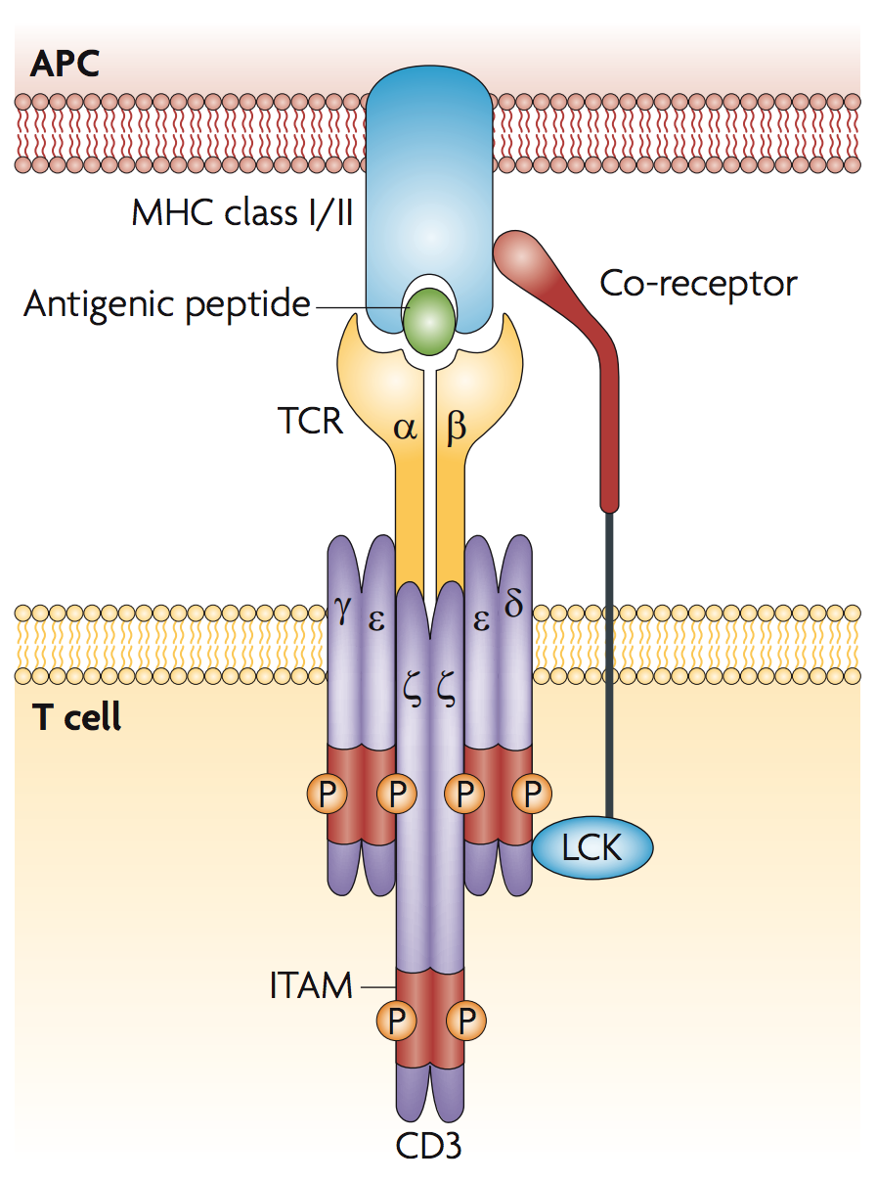
TCR specificity
Notes:
Inset: one of the 2304 individual reaction chambers (RC) and the associated containment valves (CV) and interface valve (IV)

Slide 7
TCR specificity
Notes:
Inset: one of the 2304 individual reaction chambers (RC) and the associated containment valves (CV) and interface valve (IV)

Slide 8
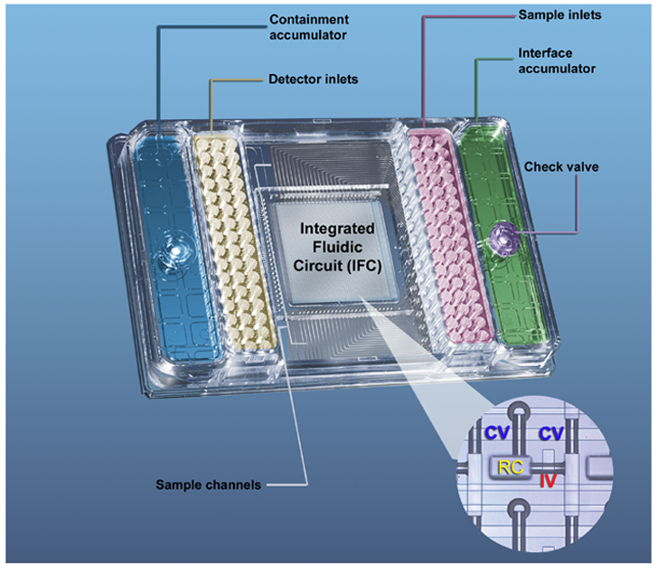
Single-cell characterization of T-cell subpopulations in a mouse model of type 1 diabetes
Notes:
Inset: one of the 2304 individual reaction chambers (RC) and the associated containment valves (CV) and interface valve (IV)

Slide 9
qPCR quantification
Target DNA is doubled every amplification cycle
Relative target DNA quantification depends on:
Detection Threshold
Limit of Detection (LOD)
1 copy = 2⁰
2 copies = 2¹
4 copies = 2²
8 copies = 2³
Notes:
denaturation, annealing, extension

Slide 10
qPCR quantification
Target DNA is doubled every amplification cycle
Relative target DNA quantification depends on:
Detection Threshold = 8
Limit of Detection (LOD)
1 copy = 2⁰
2 copies = 2¹
4 copies = 2²
8 copies = 2³
Notes:
denaturation, annealing, extension

Slide 11
qPCR quantification
Target DNA is doubled every amplification cycle
Relative target DNA quantification depends on:
Detection Threshold = 8
Limit of Detection (LOD)
= cycle 3
1 copy = 2⁰
2 copies = 2¹
4 copies = 2²
8 copies = 2³
Notes:
denaturation, annealing, extension

Slide 12
qPCR quantification
4 copies = 2²
8 copies = 2³
Notes:
denaturation, annealing, extension

Slide 13
qPCR quantification
2^{(LOD - threshold cycle)} = 2²
4 copies = 2²
8 copies = 2³
Notes:
denaturation, annealing, extension

Slide 14
Data points
1746 T cells
96 genes:
cell surface receptors
signaling molecules
interferon response
chemokines
cytokines
transcription factors
2 probes:
insulin 12-20 (12)
insulin 13-21 (13)
3 tissues:
pancreatic islet
pancreatic lymph node
spleen
2 time points:
6 weeks (early)
12 weeks (late)

Slide 15
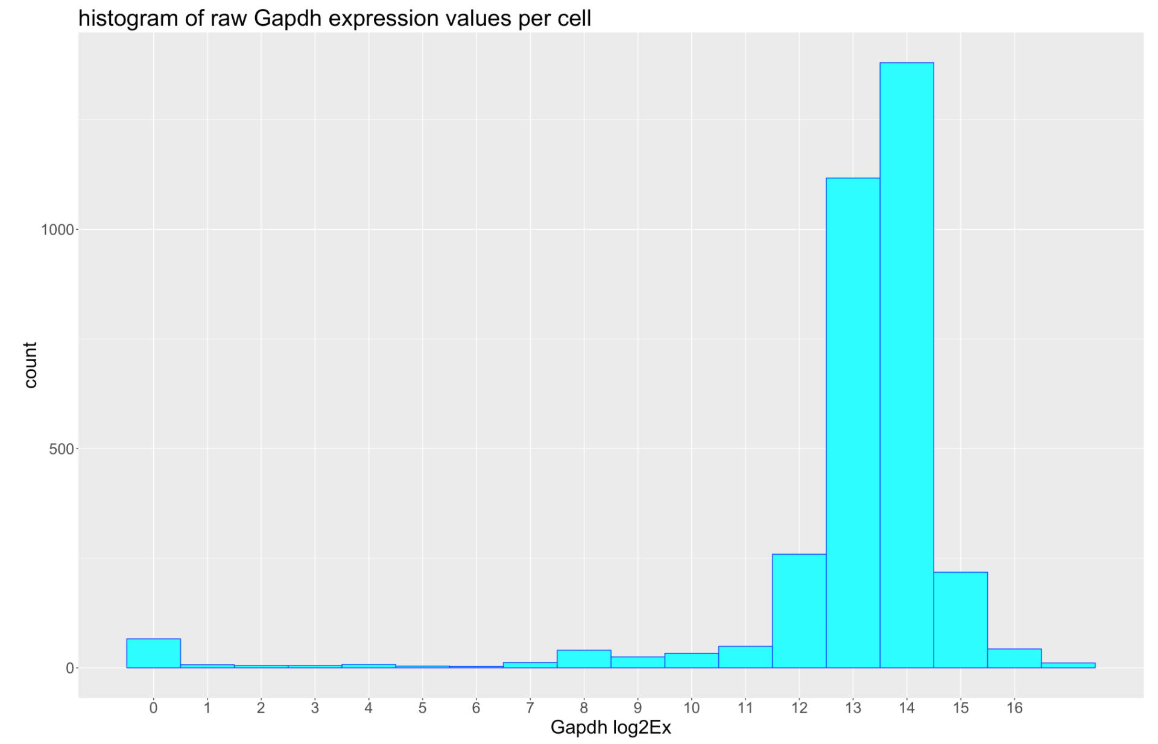
Preliminary
Filtering
No expression detected in
111 / 1746 cells
55 / 1635 cells were removed due to low Gapdh expression (< 6.75)

Slide 16
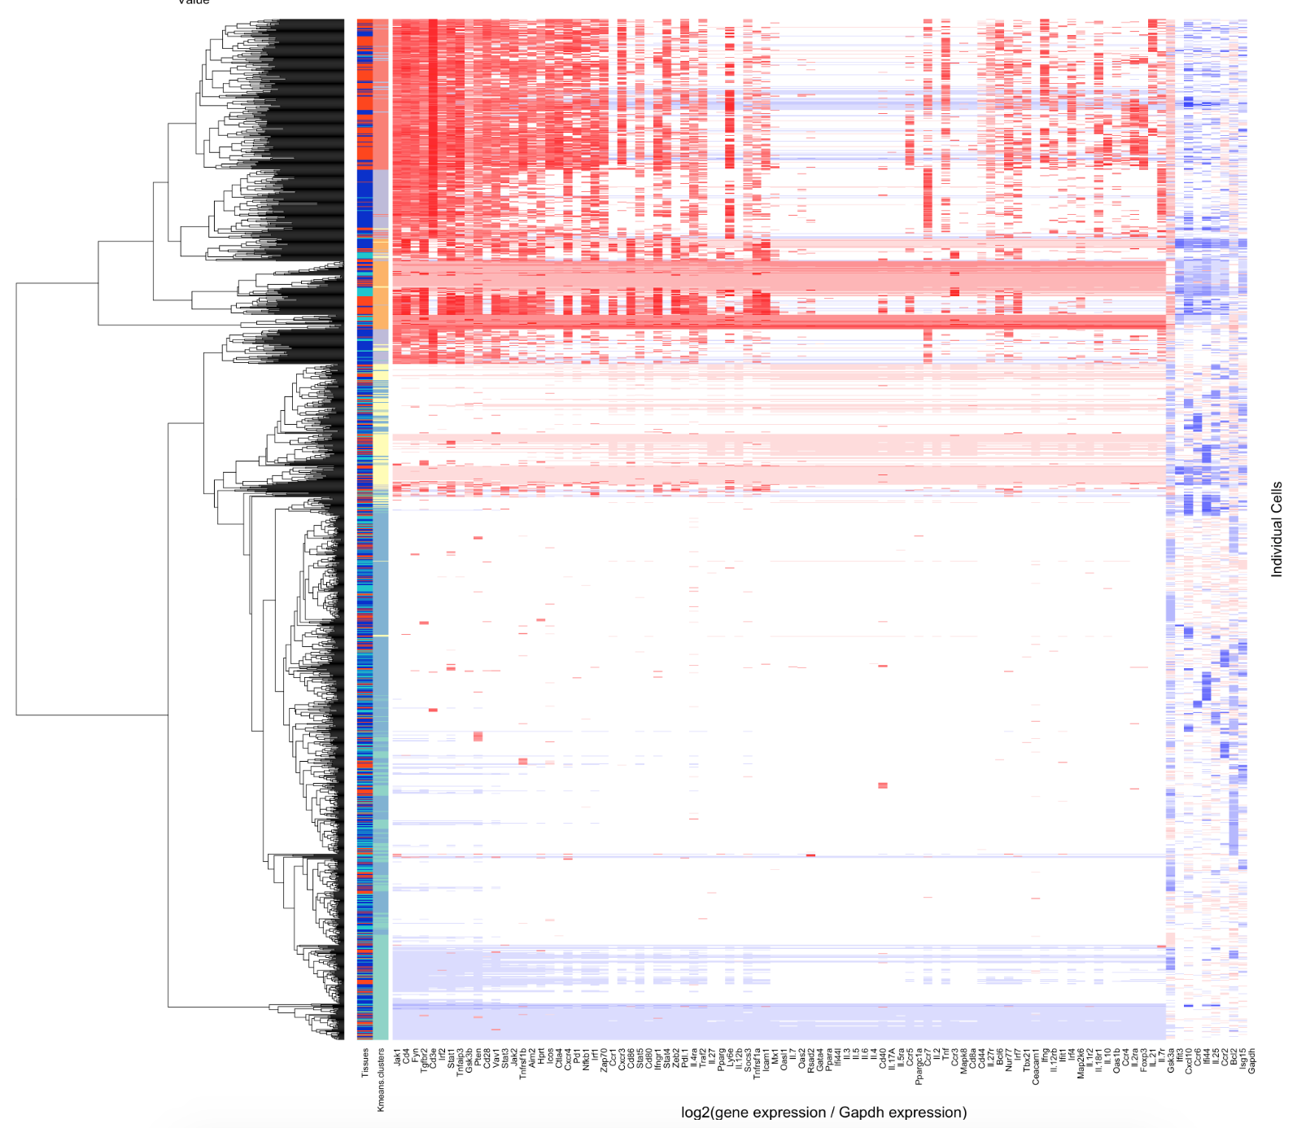
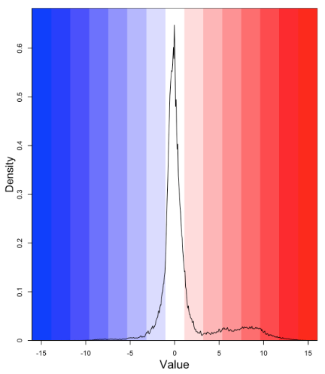
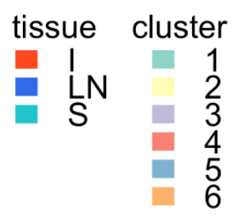
Analysis of 1580 individual T-cells from NOD mice

Slide 17
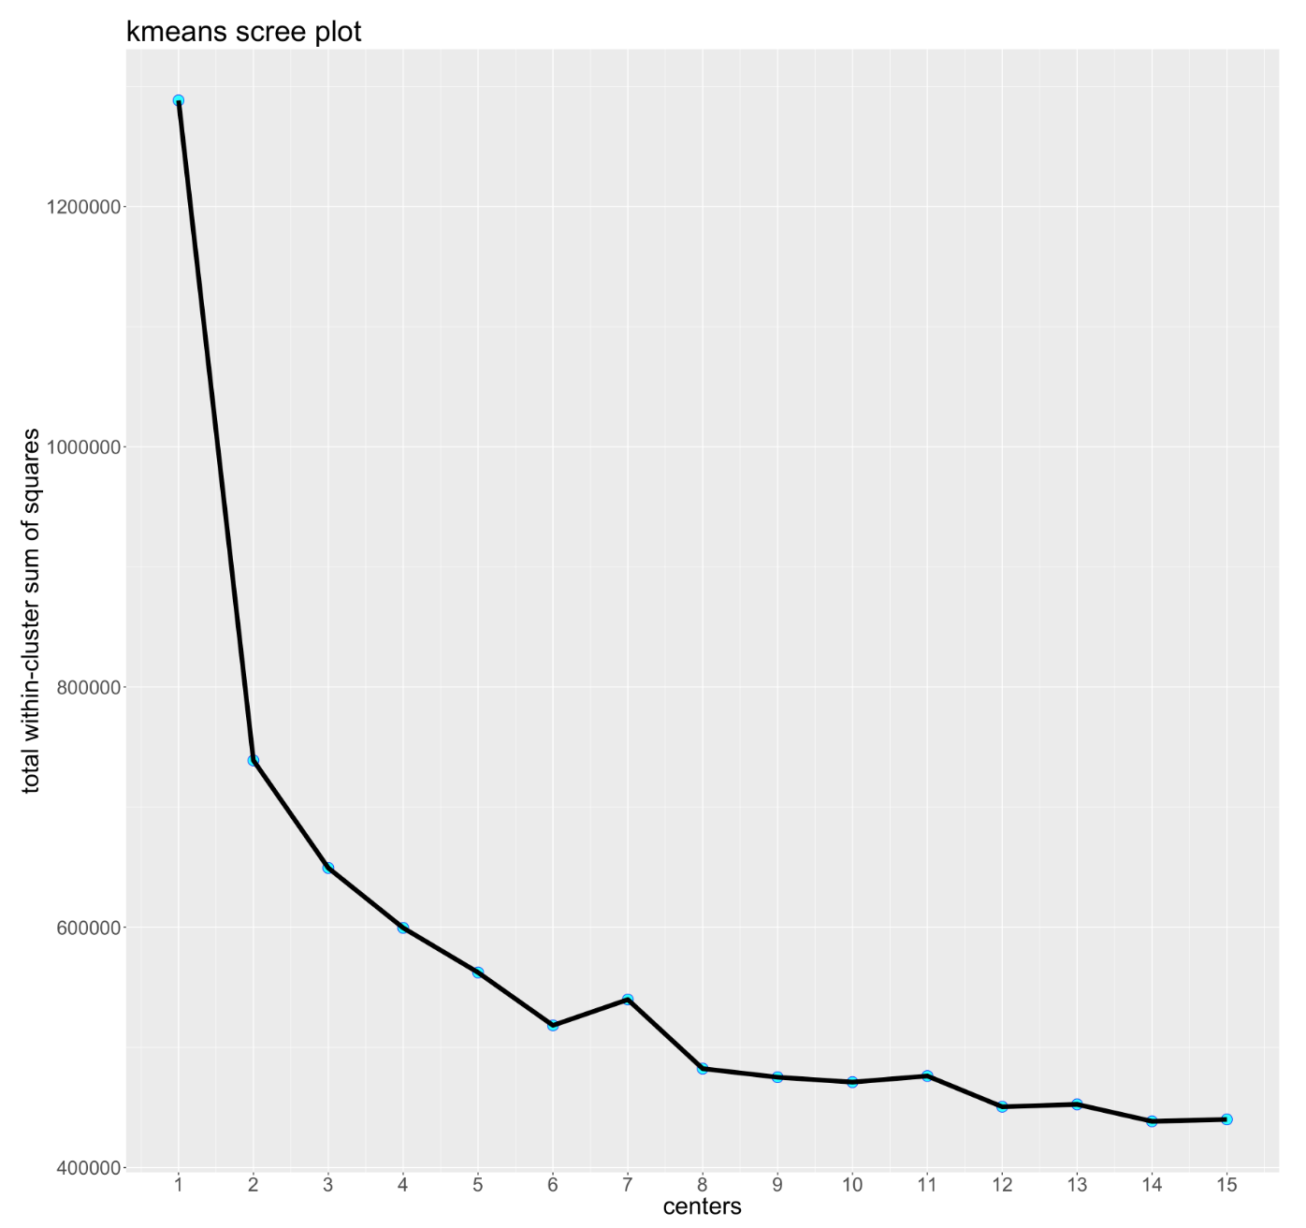
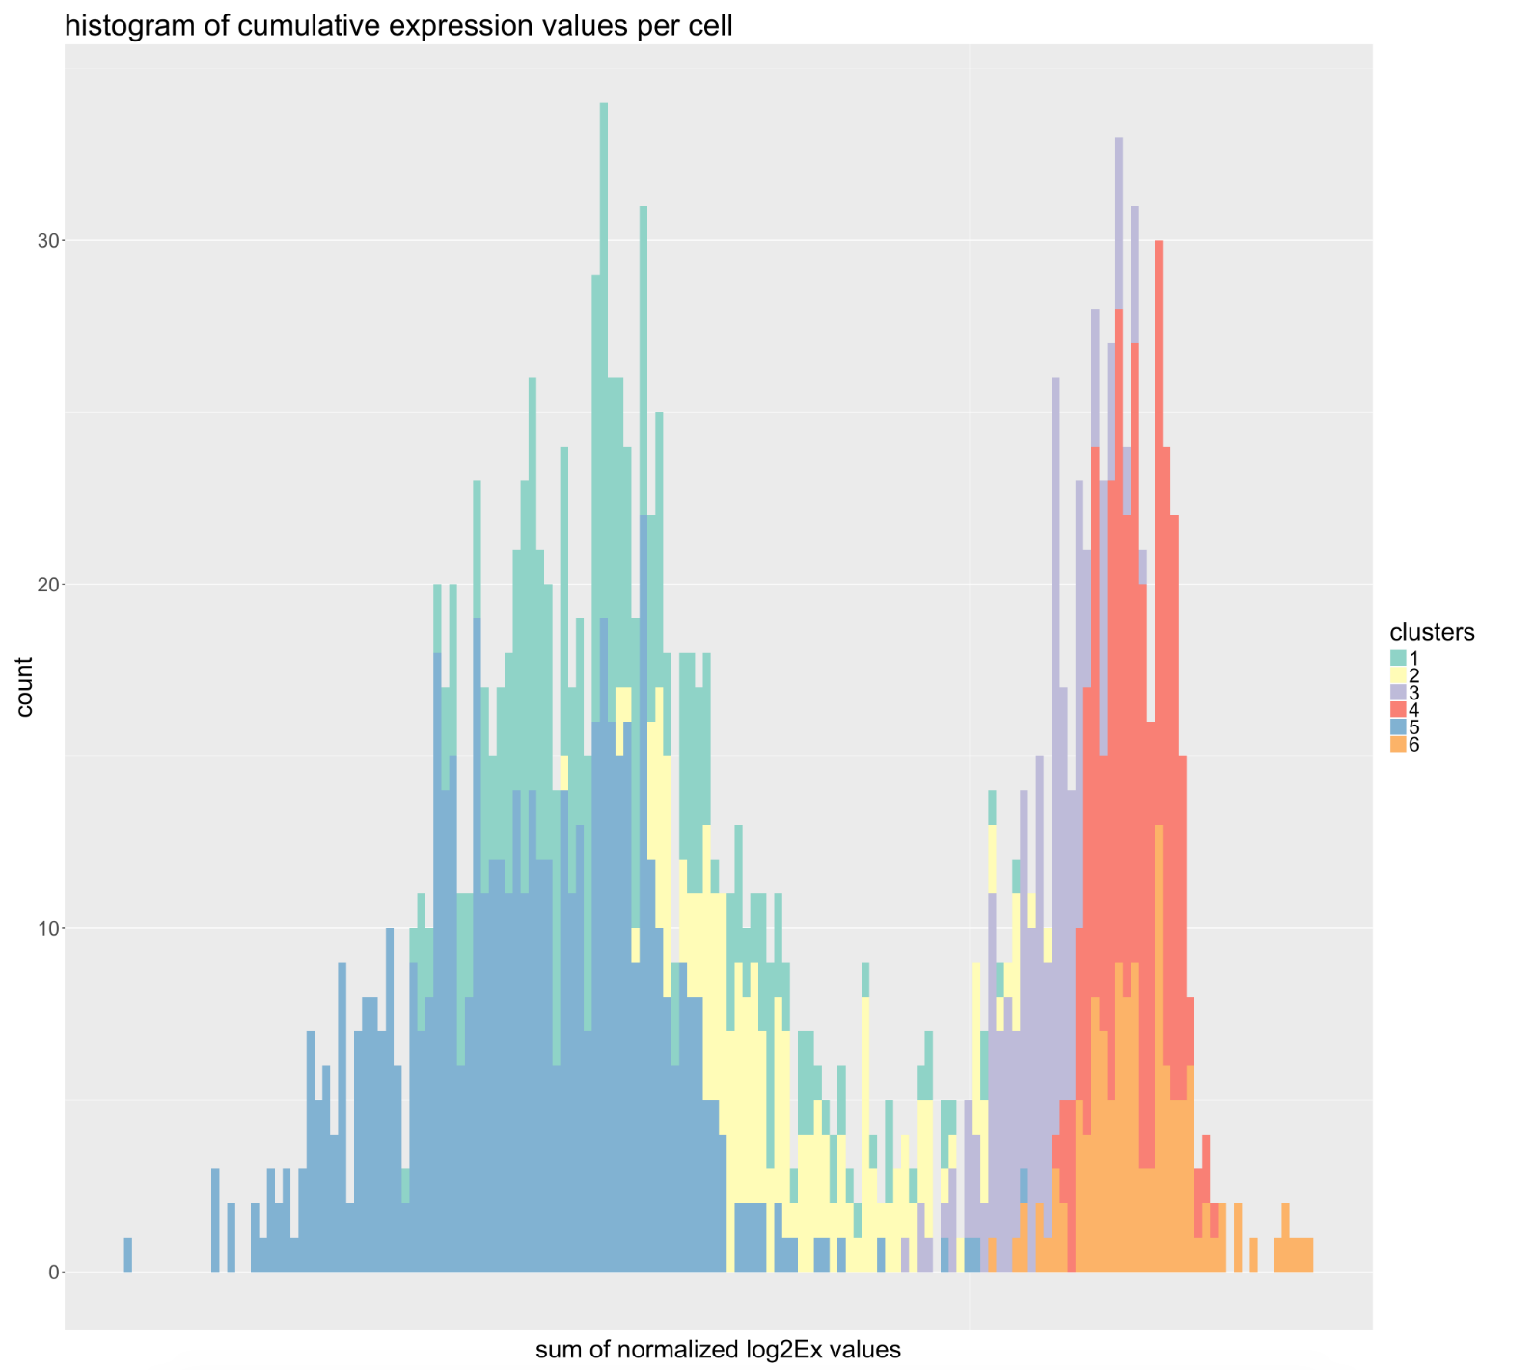
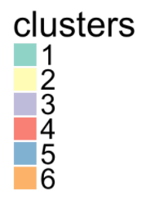
Cluster-based Filtering
1060 / 1580 cells were removed due to low gene expression (ID of removed clusters: 1, 2, 5)

Slide 18
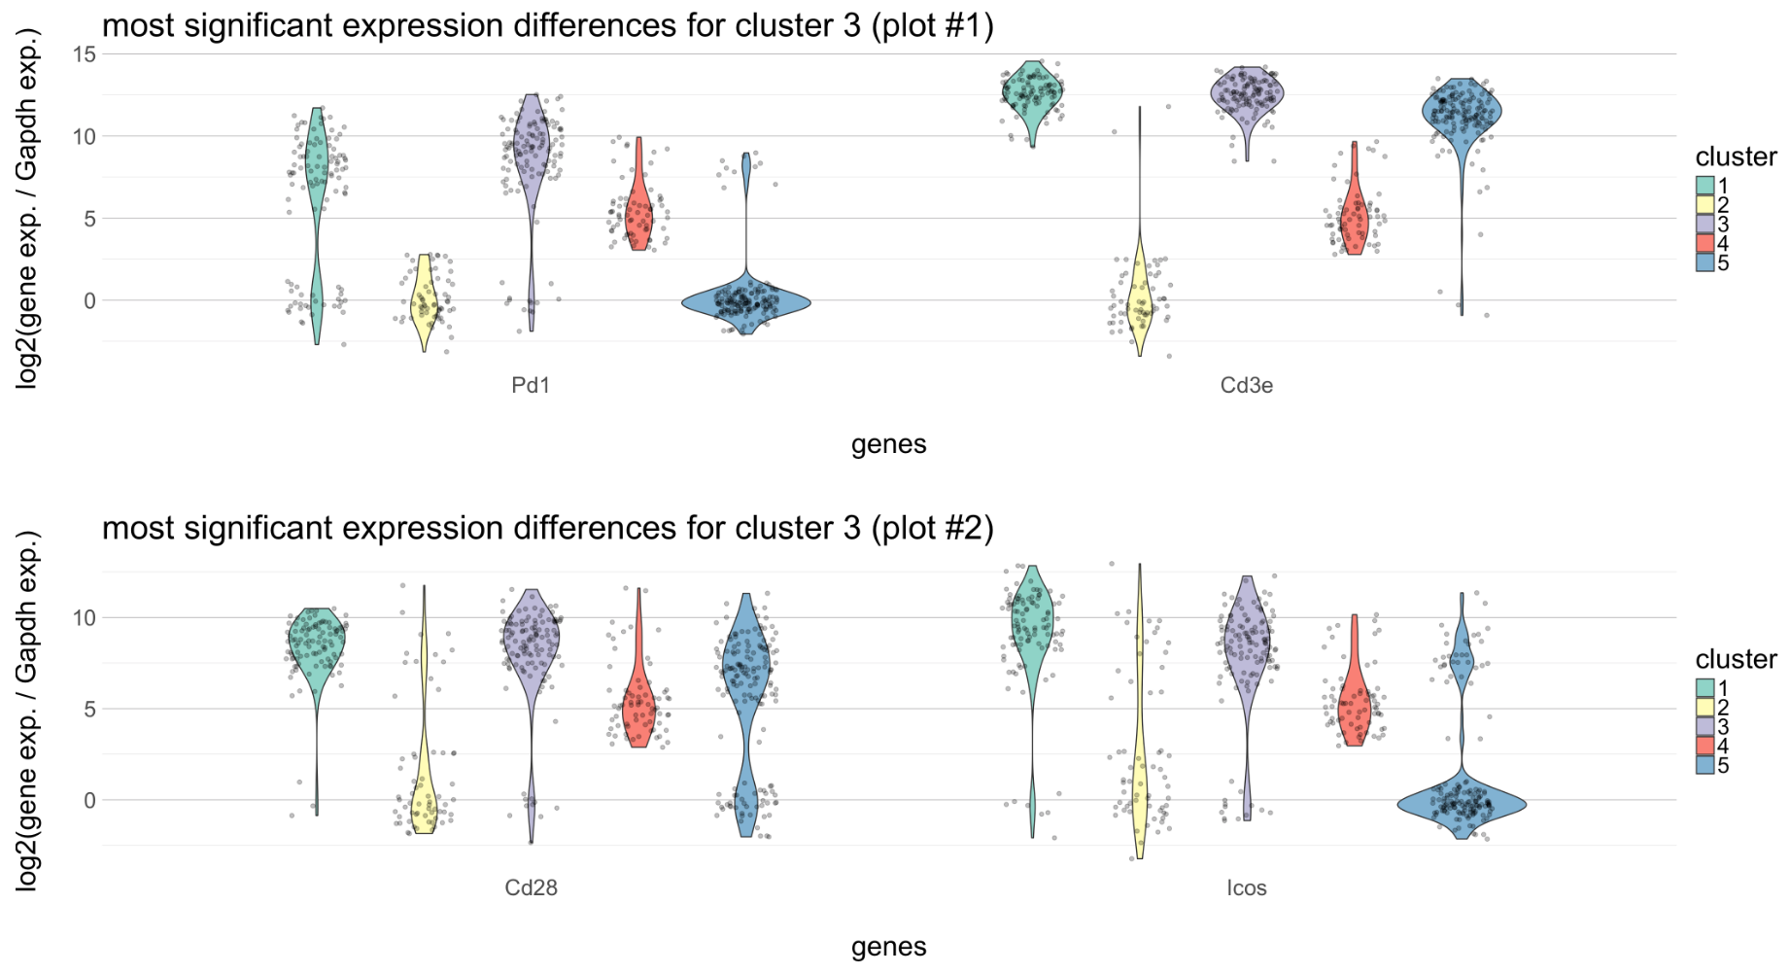
Weird cluster removal
Notes:
Filtering weird cluster removes additional 71 cells
Tissue proportions within cluster 4:
I=31%; LN=38%; S=31%
Tissue proportions across clusters (% of total tissue) for cluster 4:
9.6% of I; 11% of LN; 48.9% of S

Slide 19
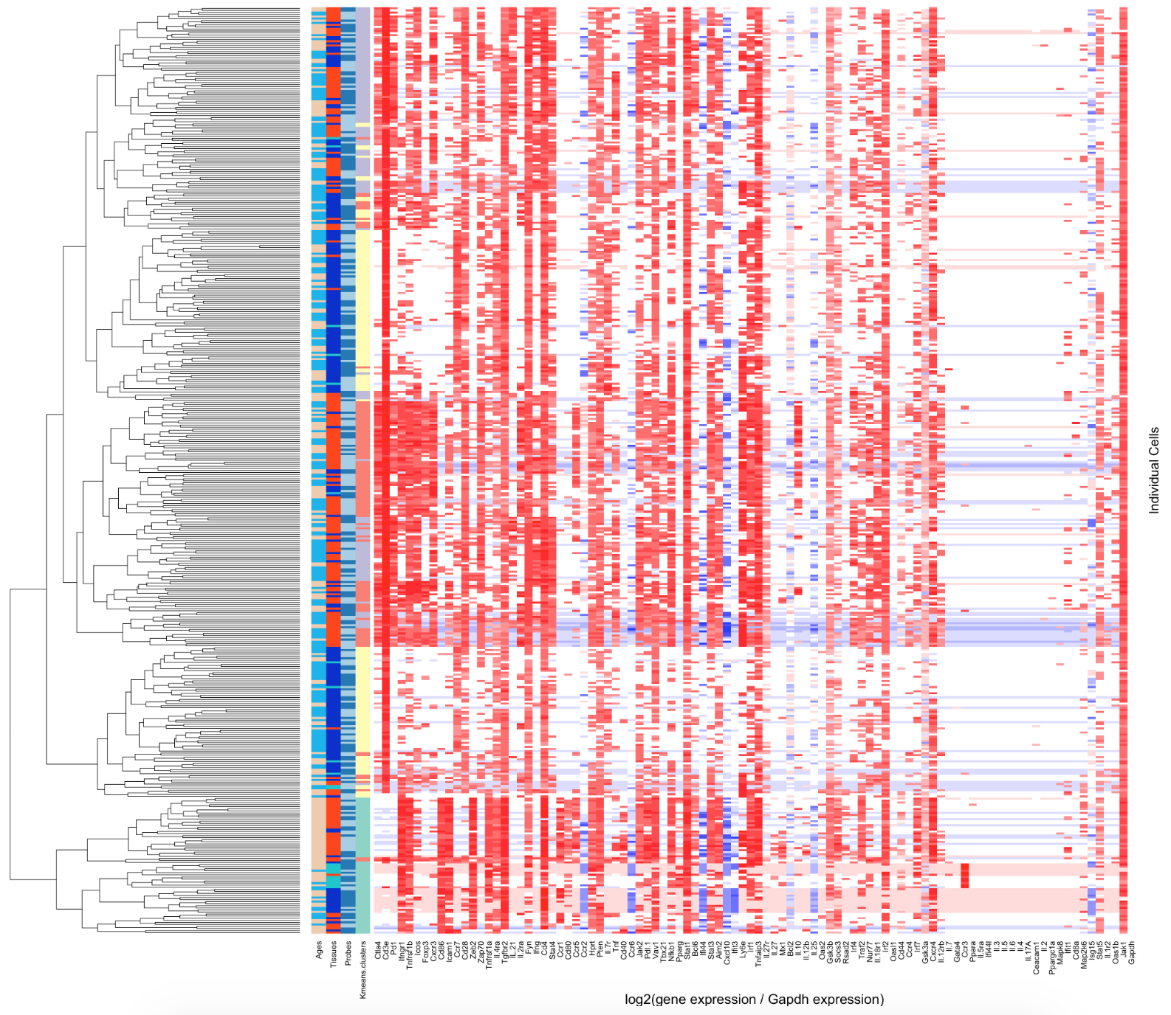
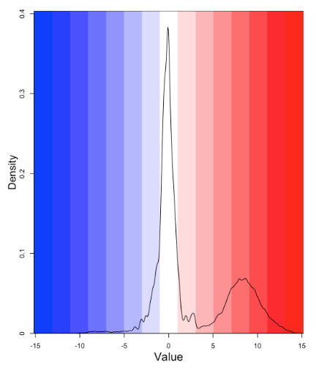
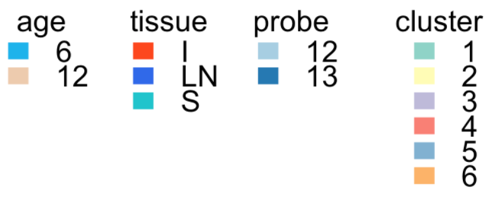
Analysis of 449 individual T-cells from NOD mice
Notes:
Filtering weird cluster removes additional 71 cells
Tissue proportions within cluster 4:
I=31%; LN=38%; S=31%
Tissue proportions across clusters (% of total tissue) for cluster 4:
9.6% of I; 11% of LN; 48.9% of S

Slide 20
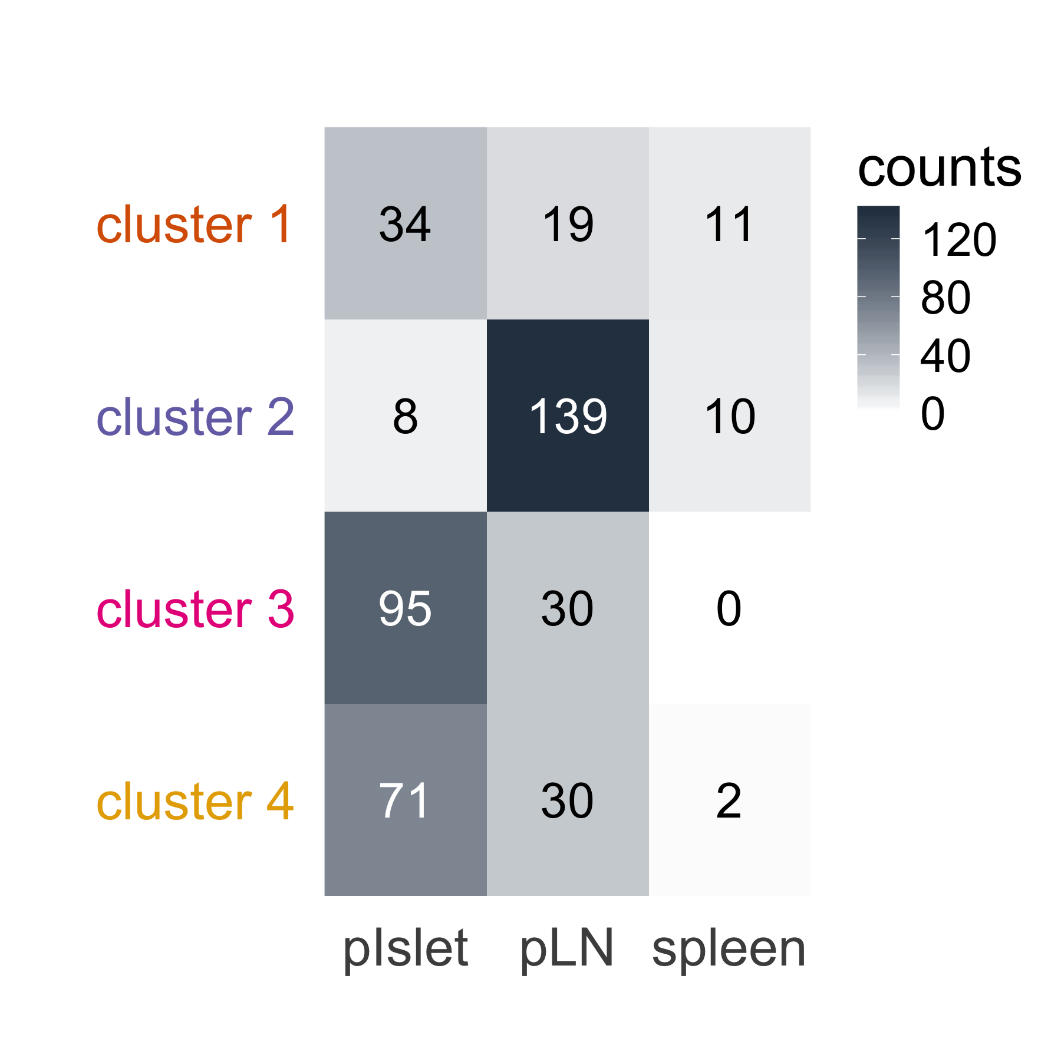
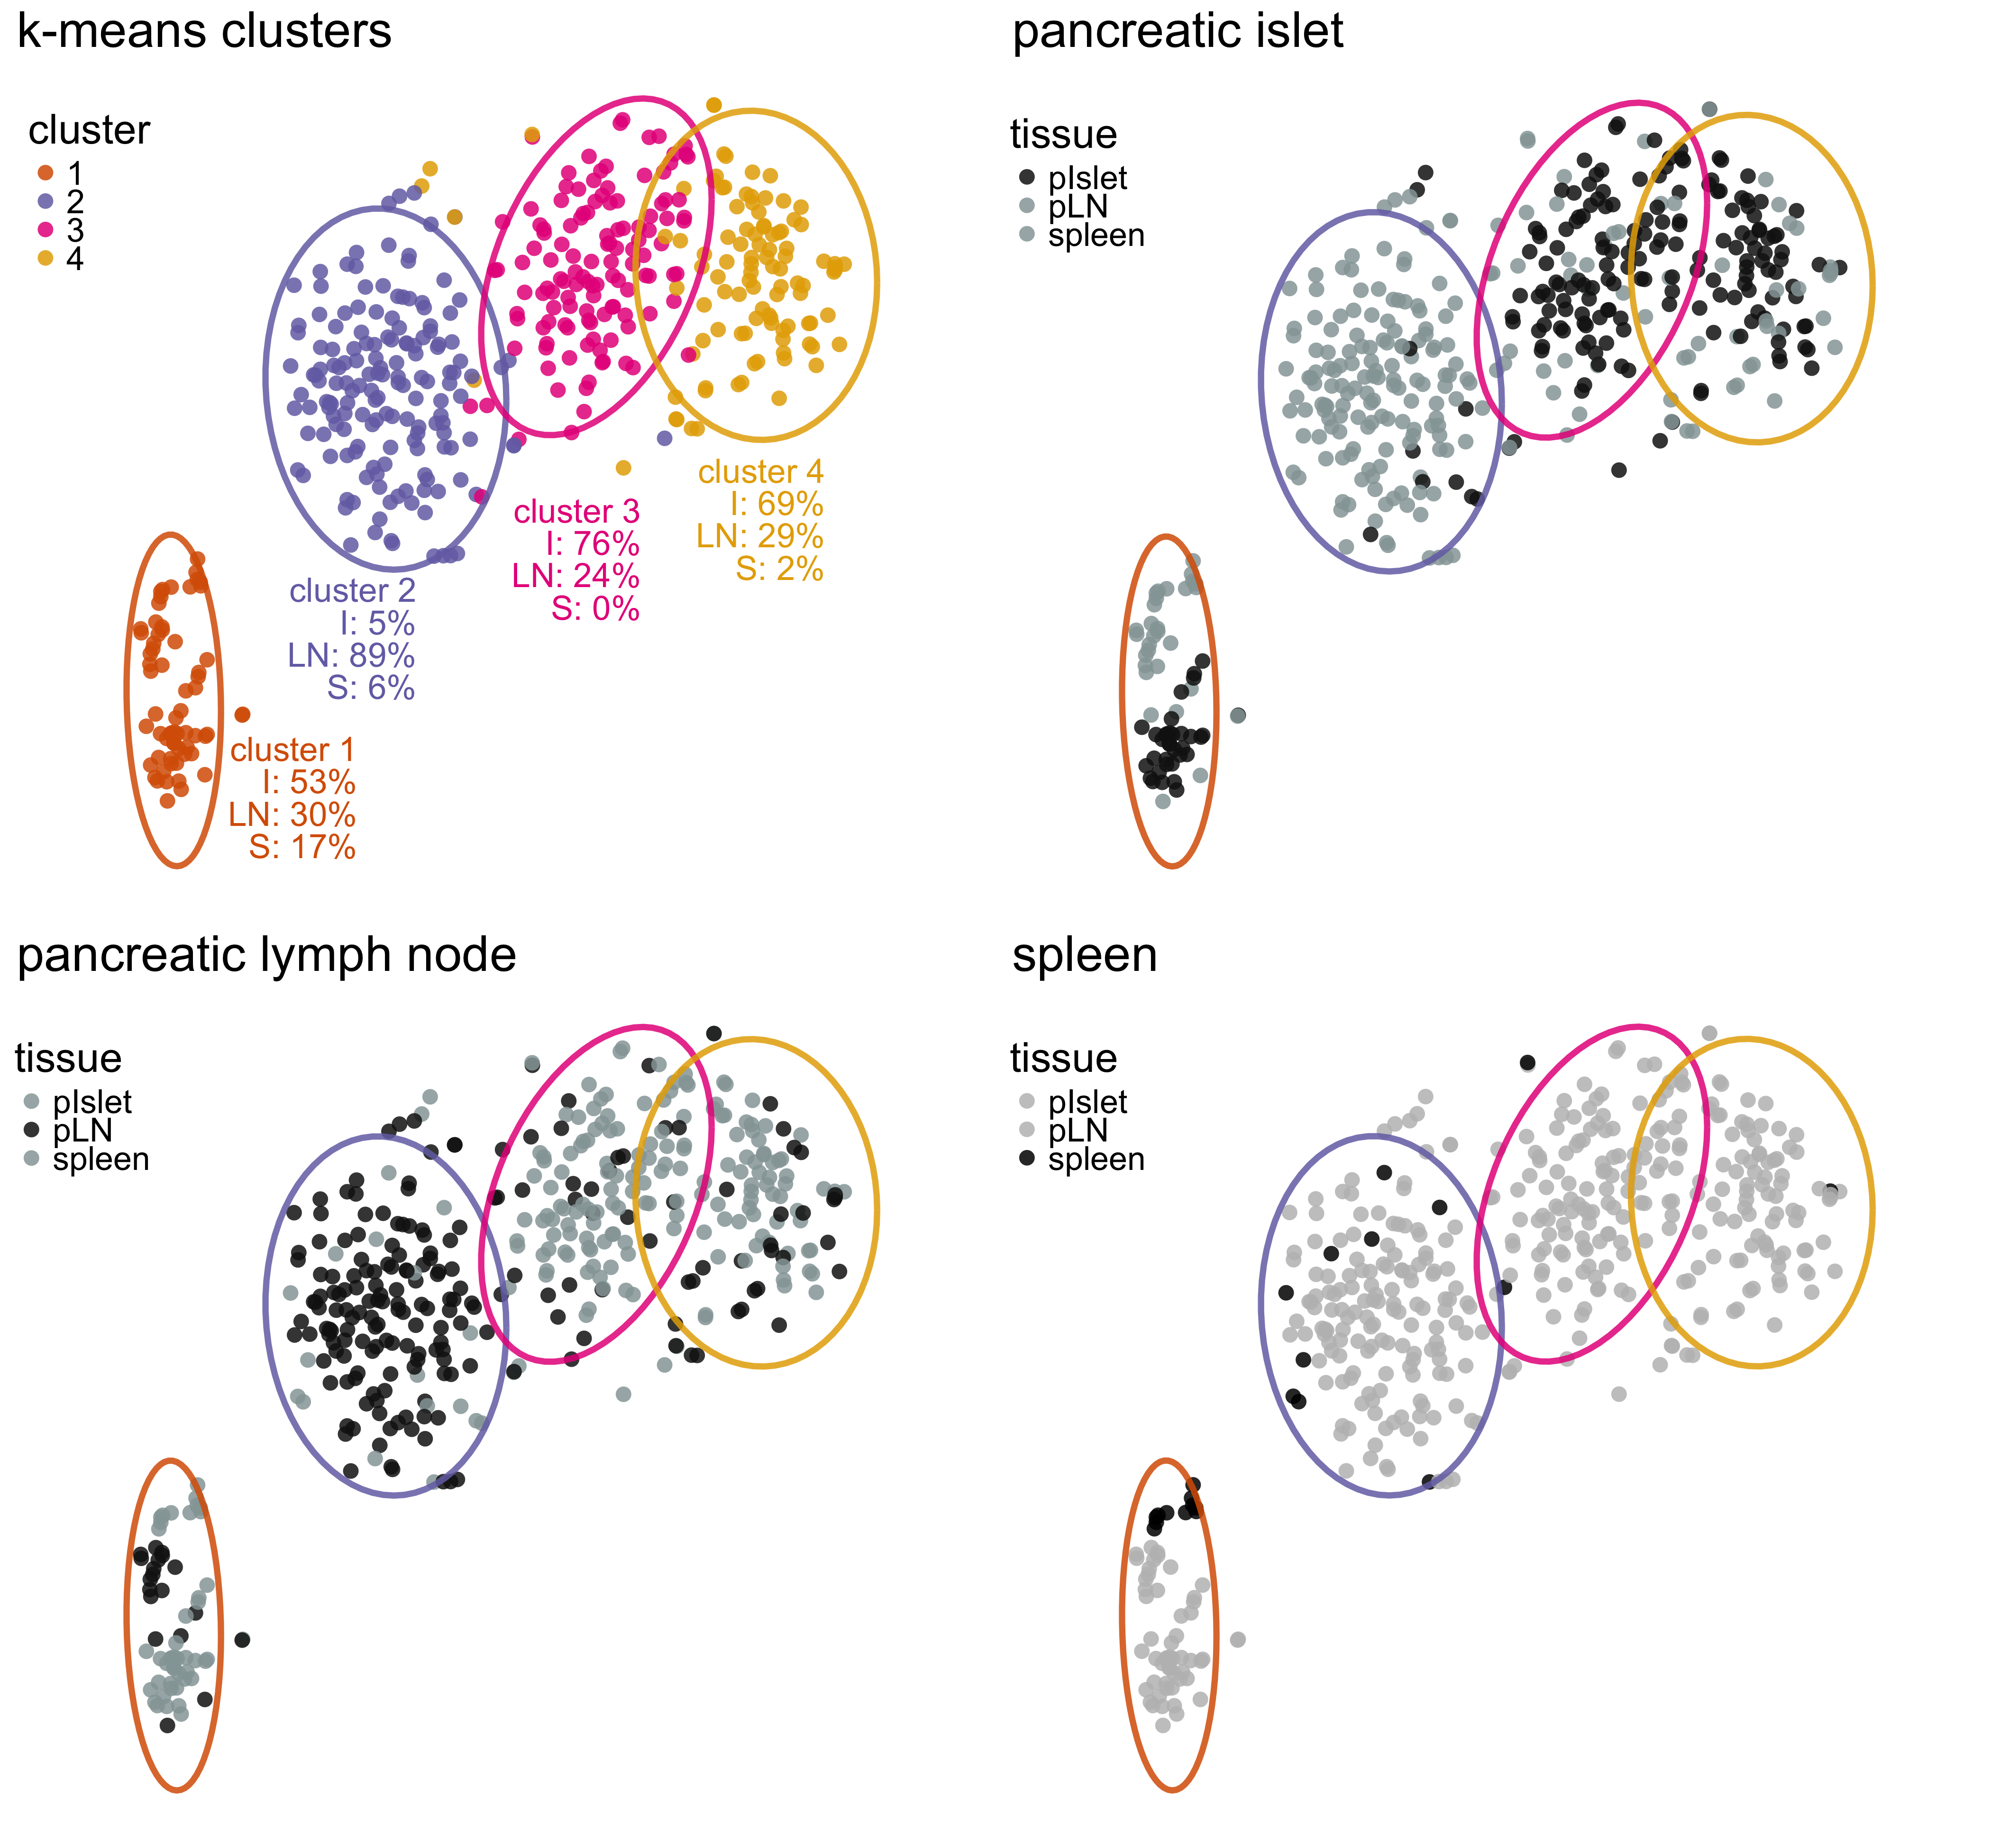
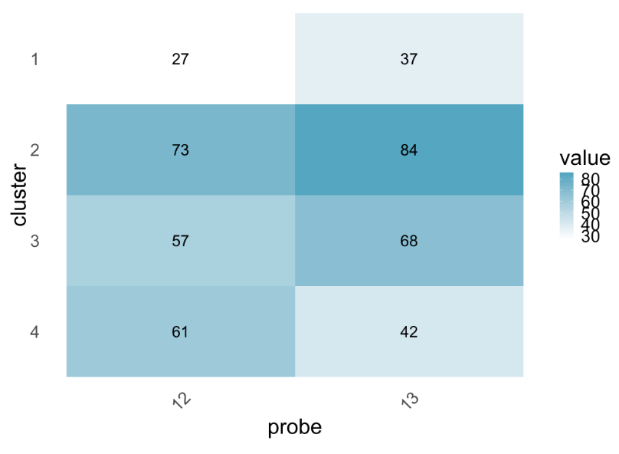

Slide 21
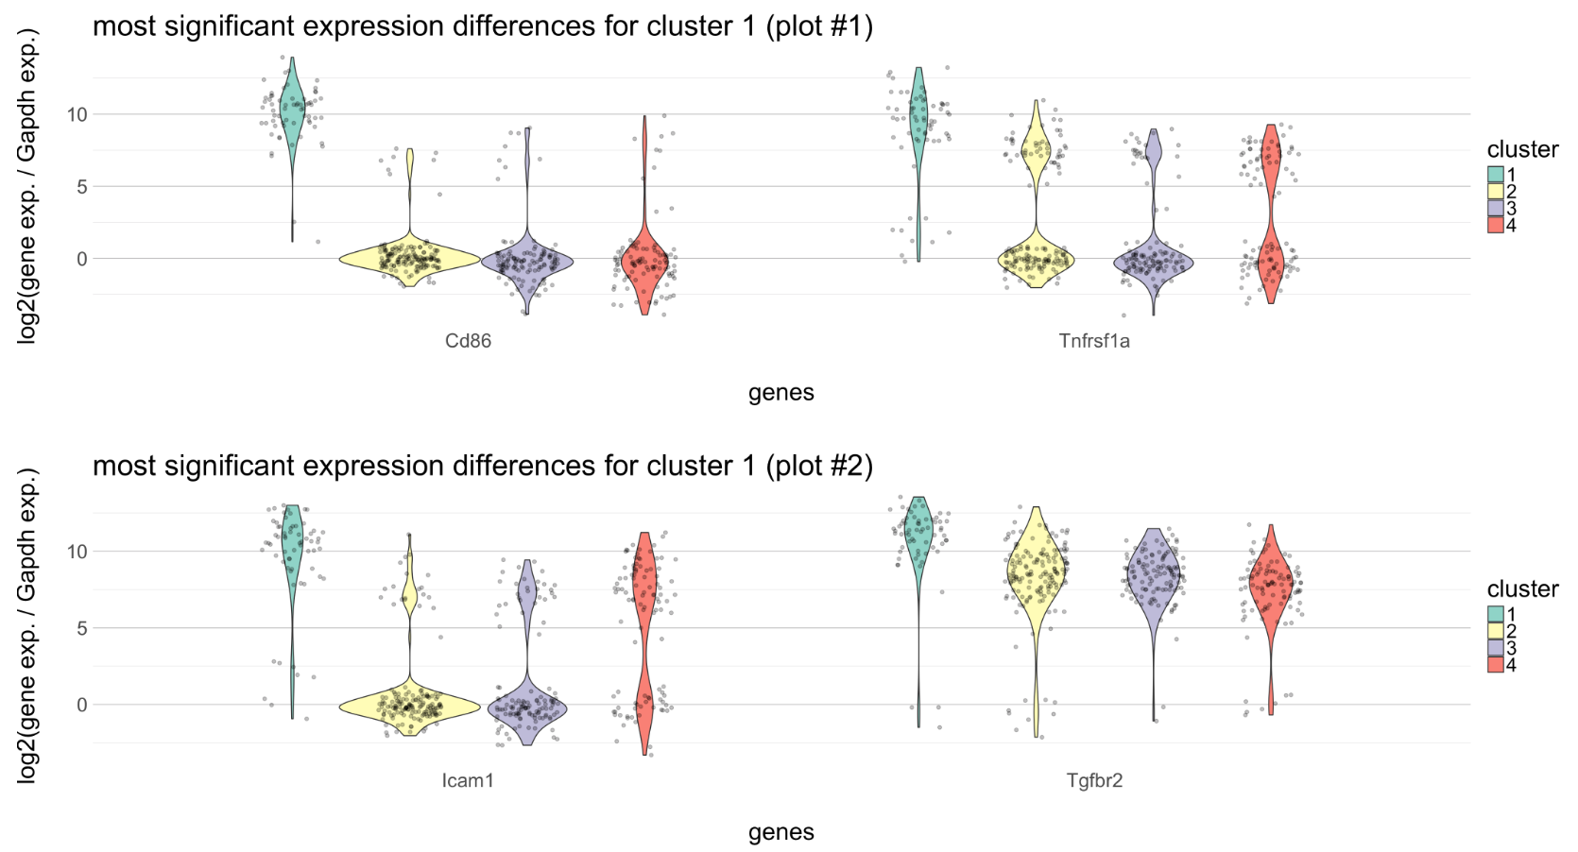
Cluster 1 expression:
Adhesion & cytokine receptors

Slide 22
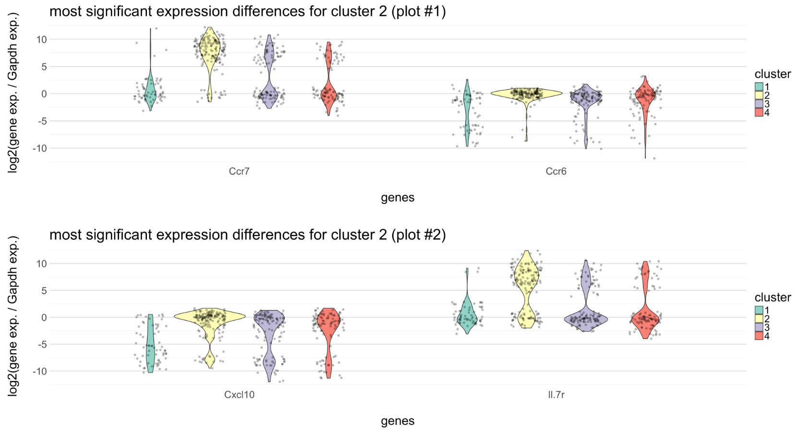
Cluster 2 expression:
Homing to the spleen

Slide 23
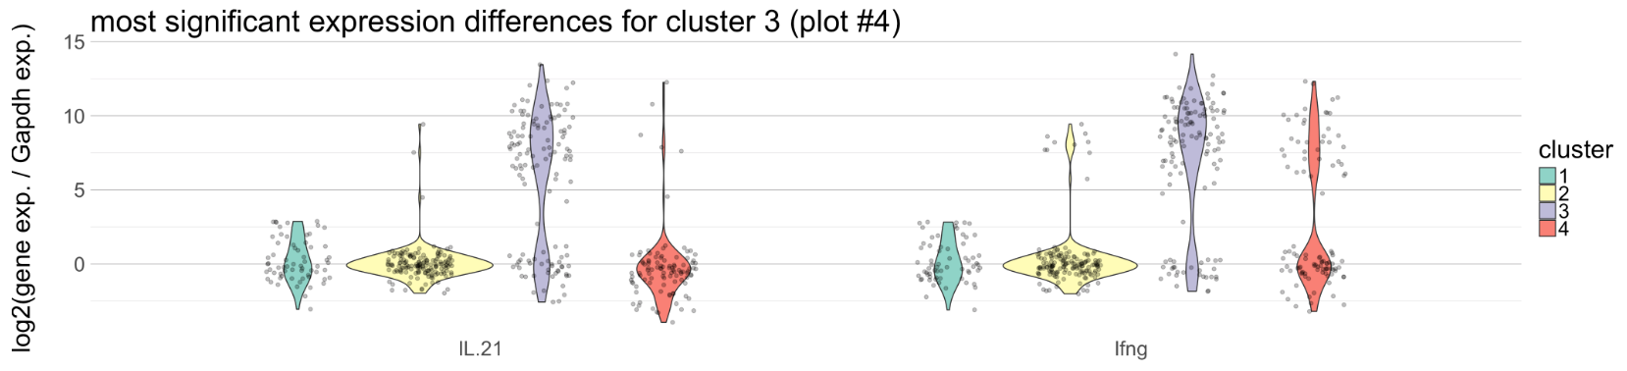
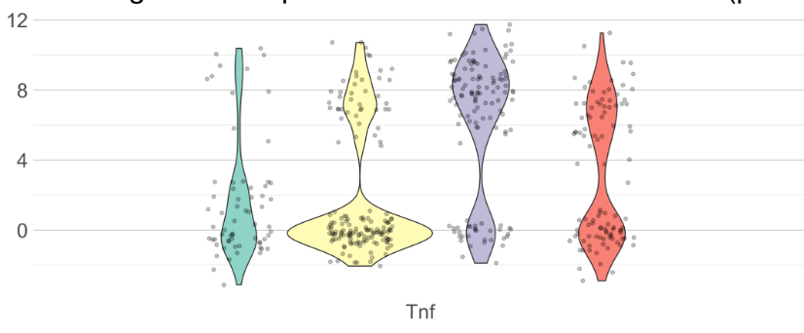
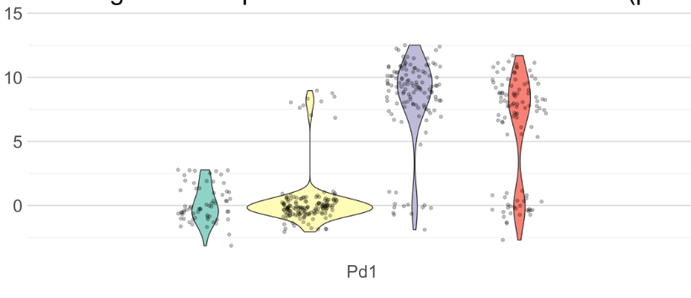
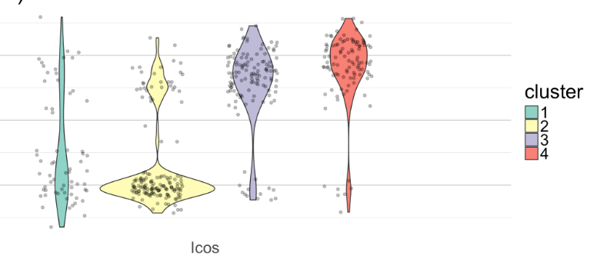
Cluster 3 expression:
Th1/Th17

Slide 24
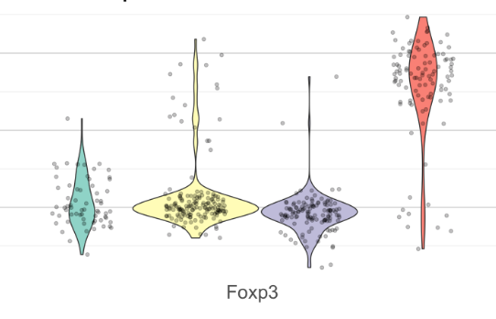
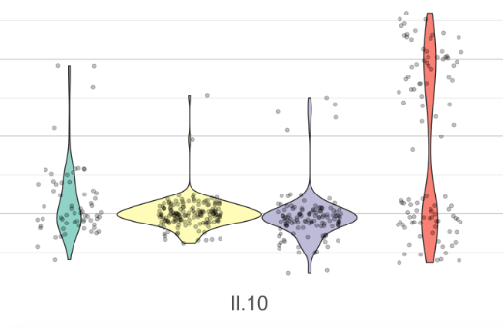
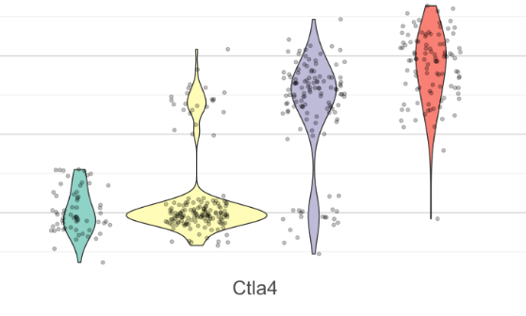
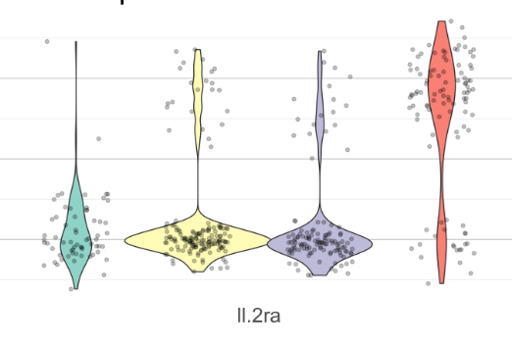
Cluster 4 expression:
Treg/Th1

Slide 25
Second study: Pd1-Icos
1 Probe: PD1 & ICOS
7 Mice: 384 T-cells from pancreatic islets and peripheral blood
6 Humans: 480 peripheral blood T-cells

Slide 26
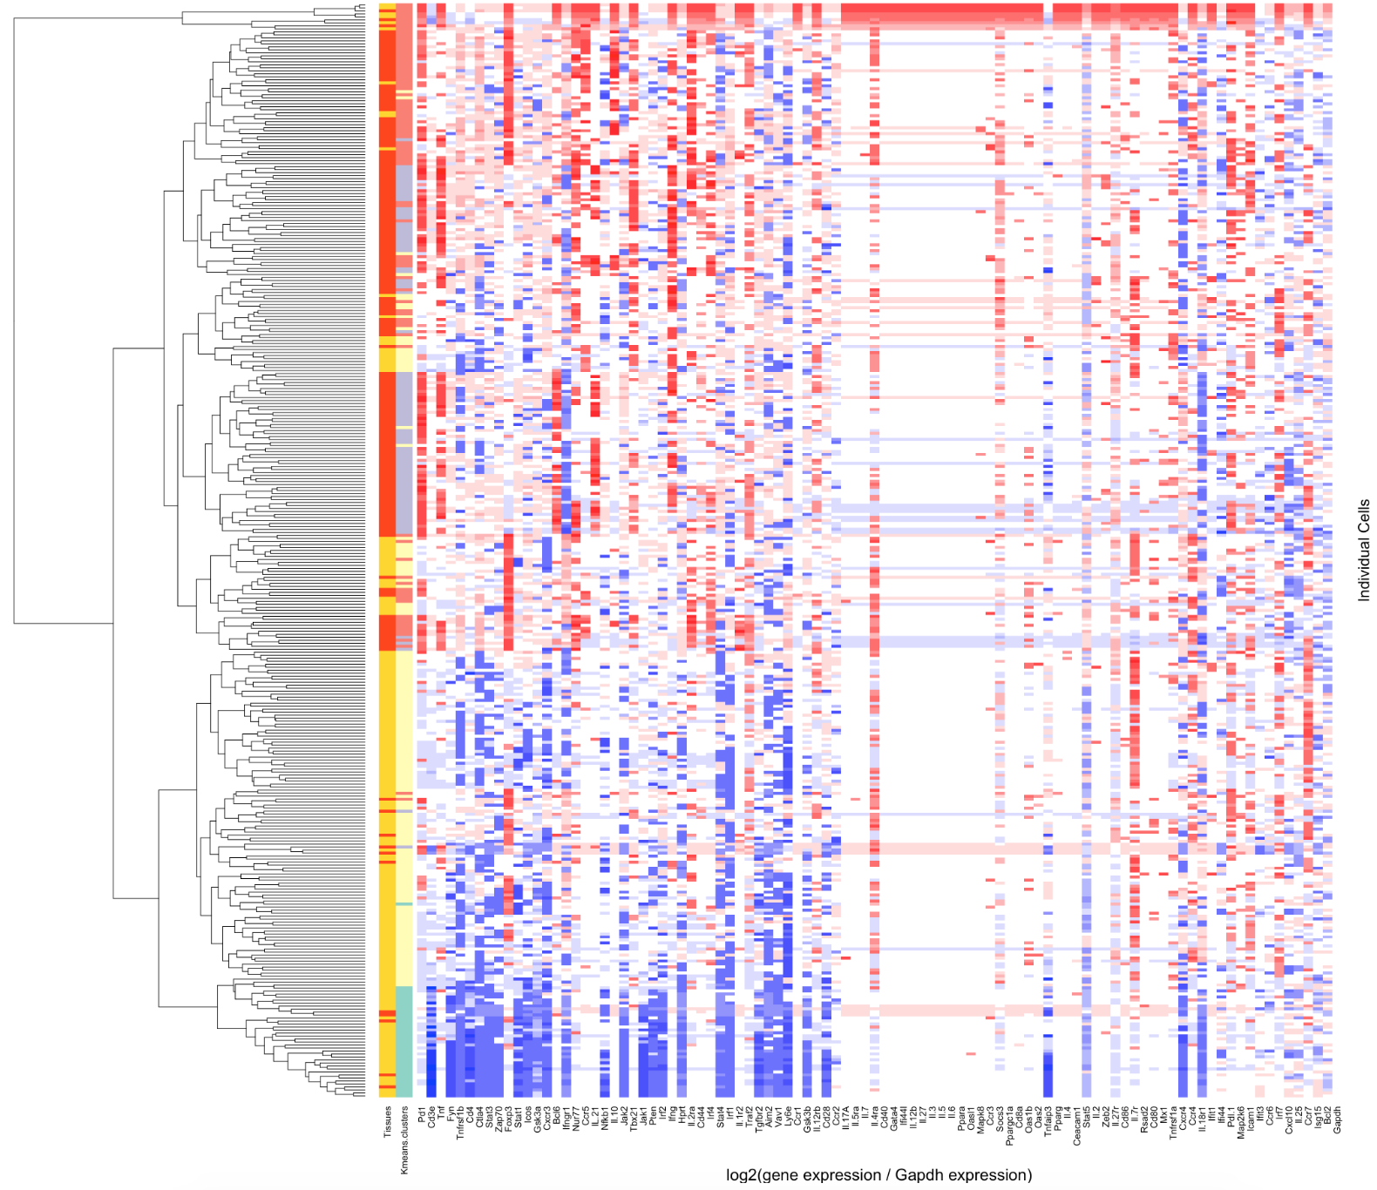

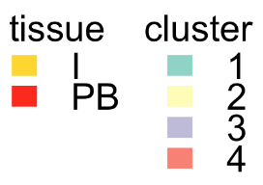
Mouse samples:
365 T cells after filtering

Slide 27
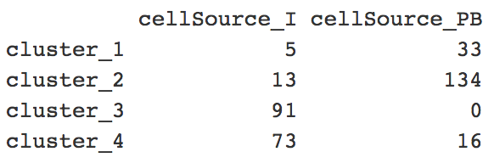
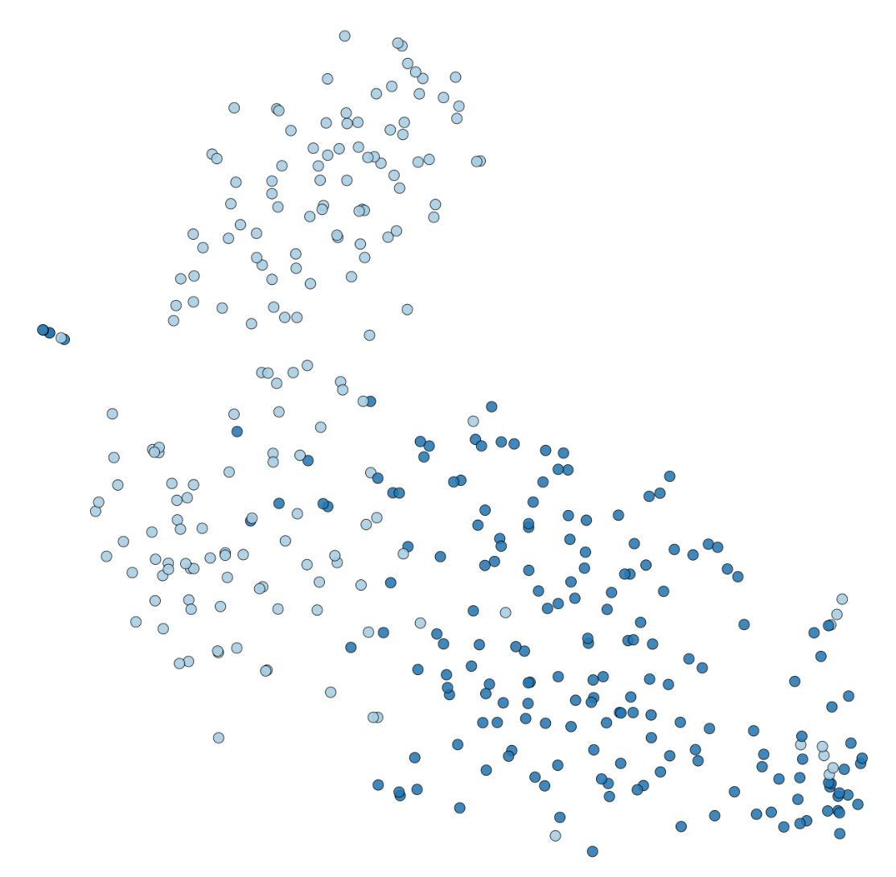
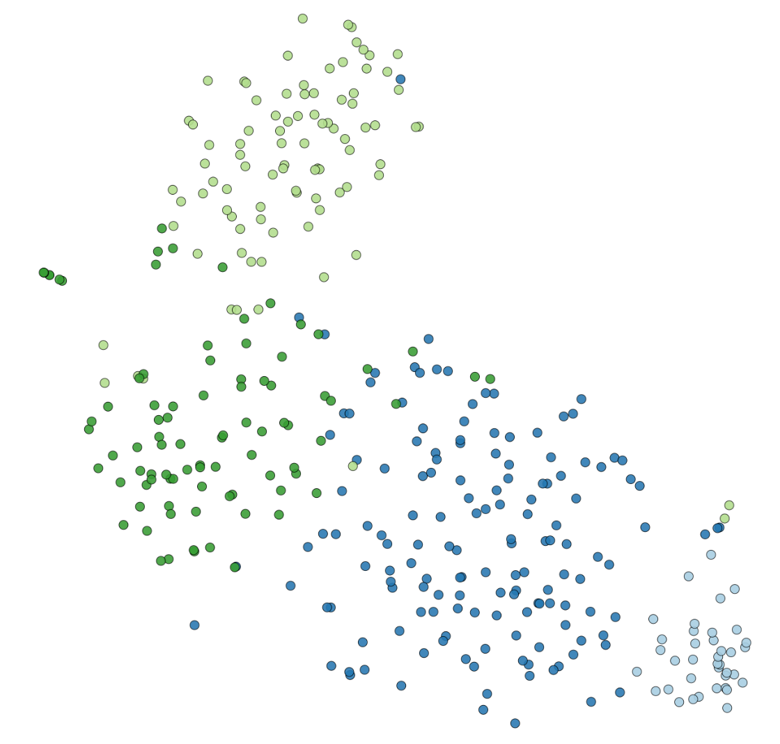
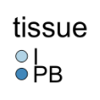
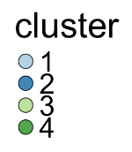
tSNE

Slide 28
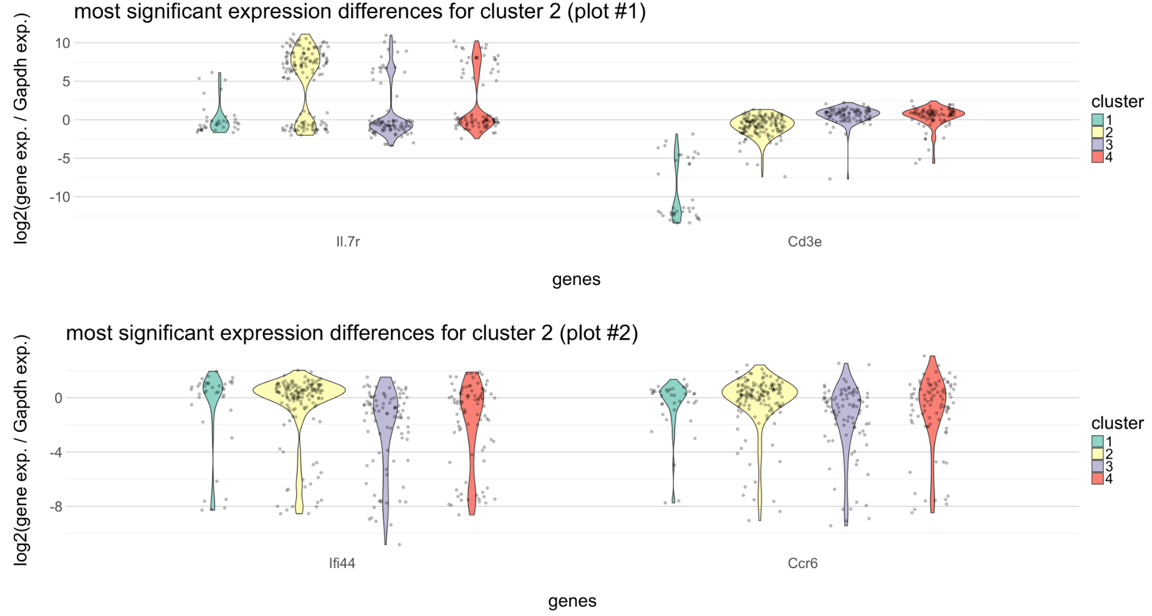
Cluster 2: Mostly naïve T cells

Slide 29
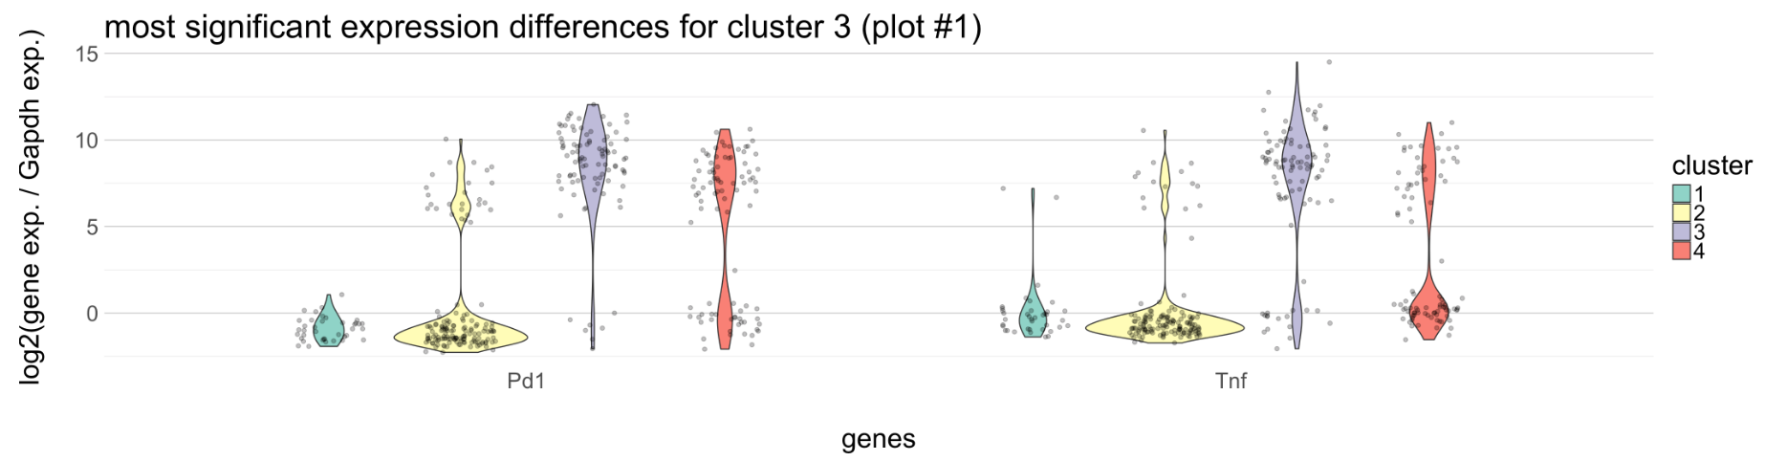
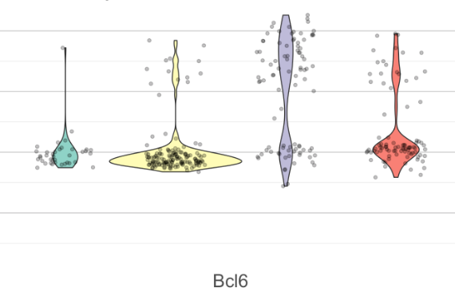
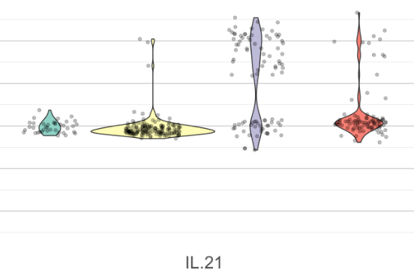
Cluster 3: Th1/Th17

Slide 30
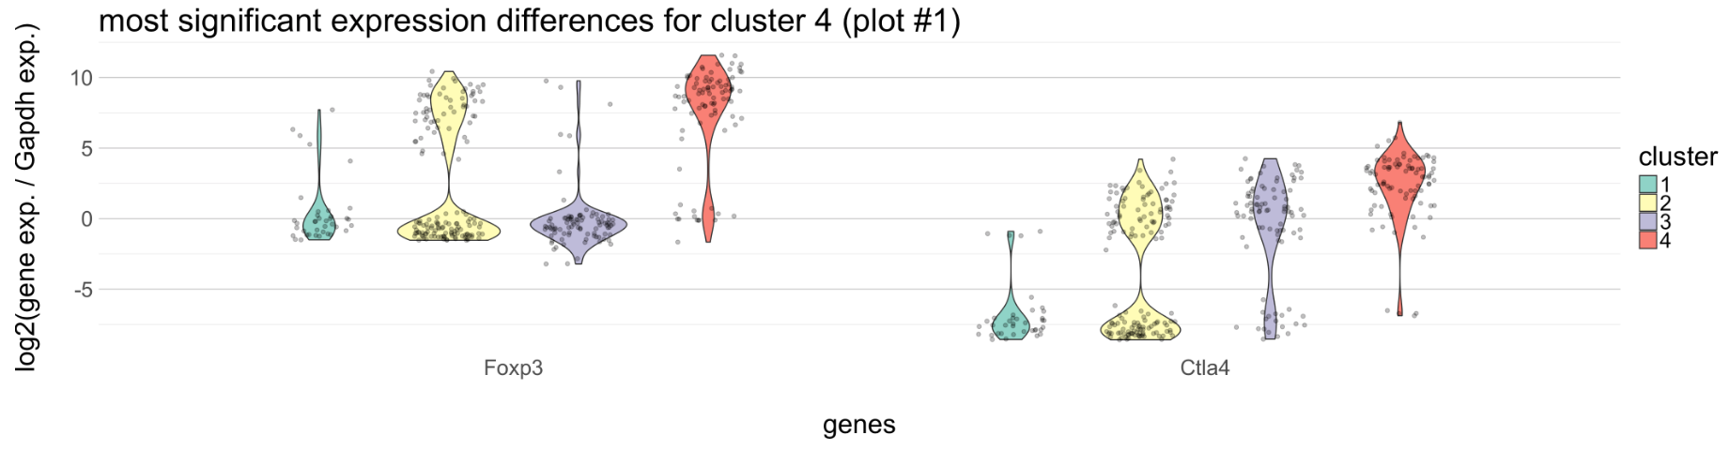
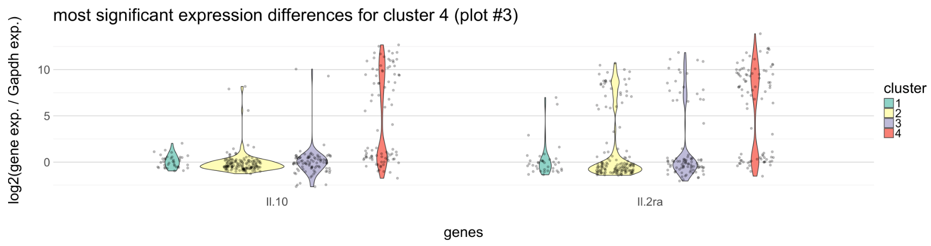
Cluster 4: Treg/Th1

Slide 31
Combining the mouse and human data
78 genes shared between the 96 gene panels
7 Mice: 384 T-cells from pancreatic islets and peripheral blood
6 Humans: 480 peripheral blood T-cells

Slide 32
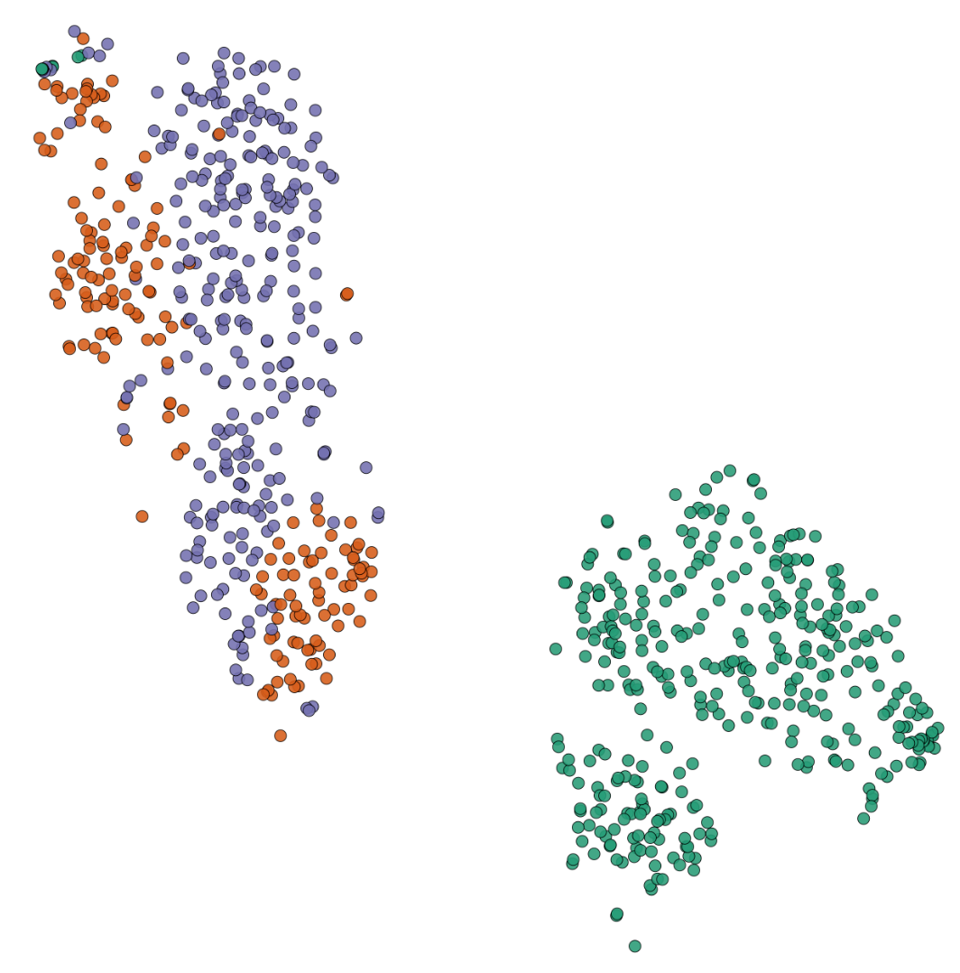
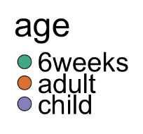
tSNE

Slide 33
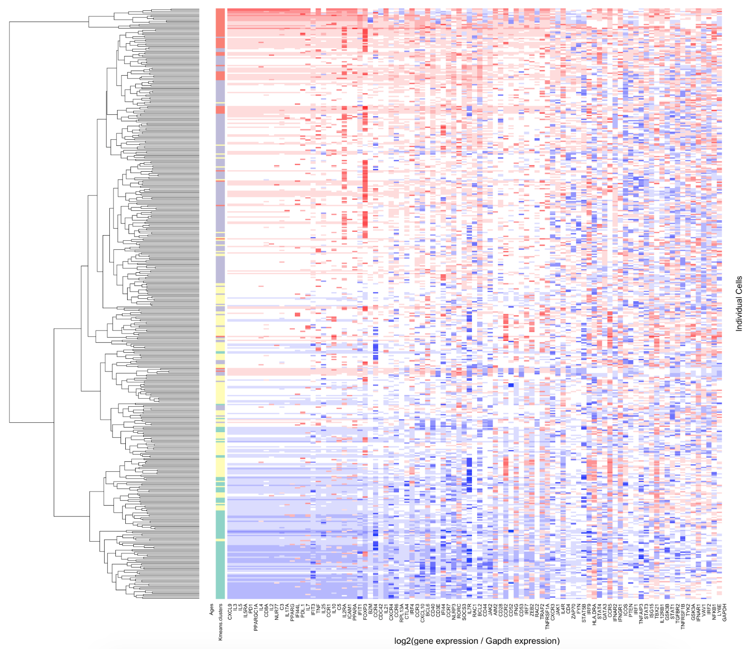
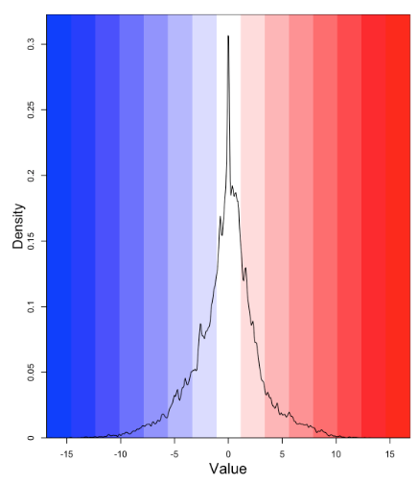
Human samples:
460 T-cells after filtering

Slide 34
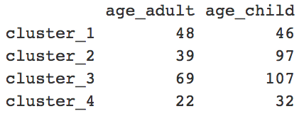
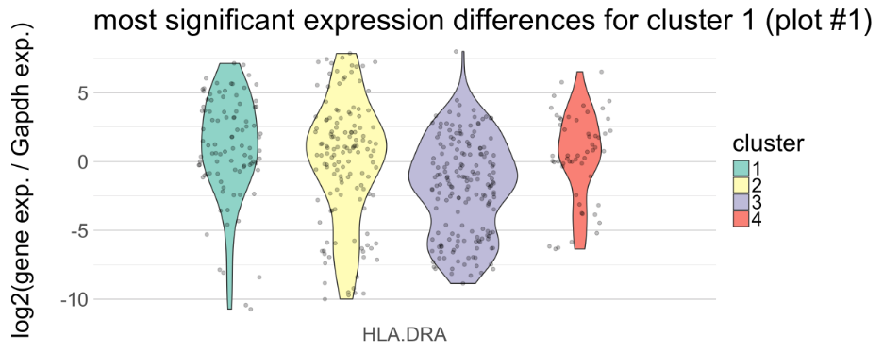
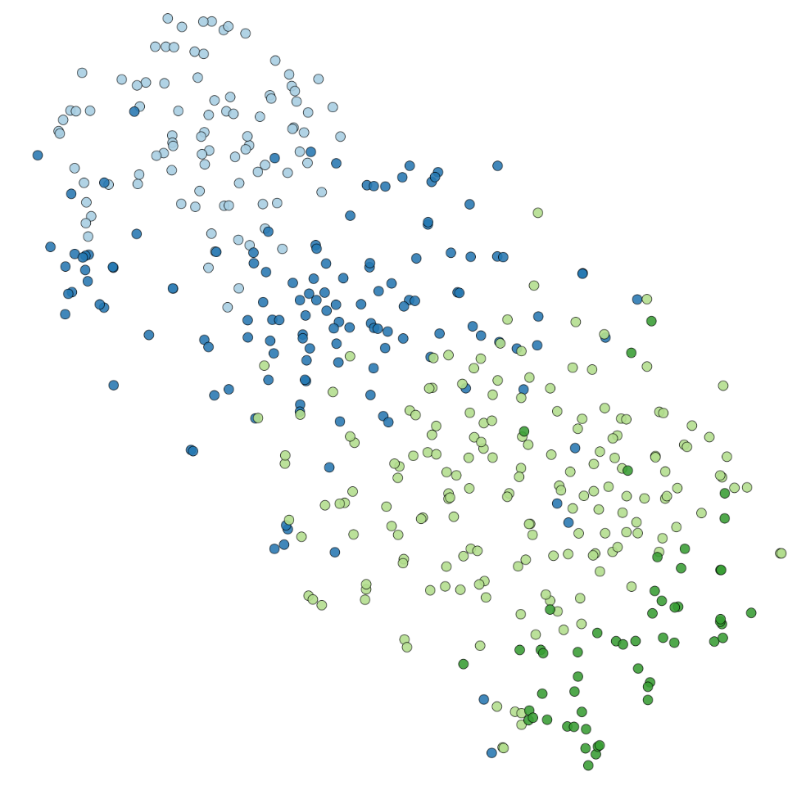
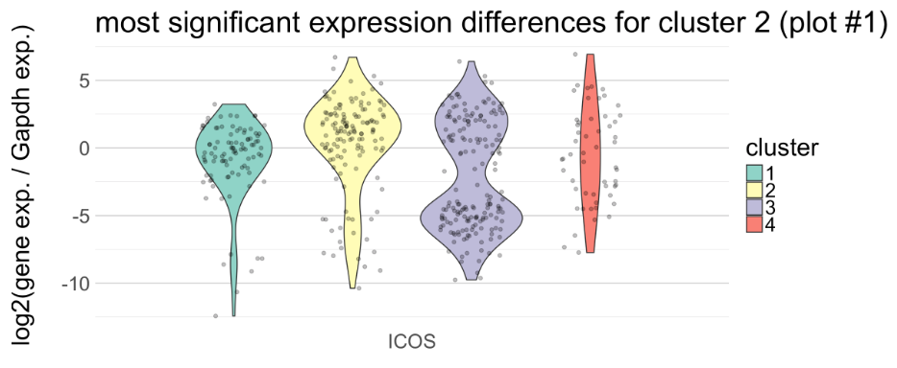
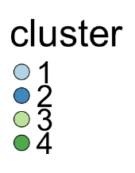

Slide 35
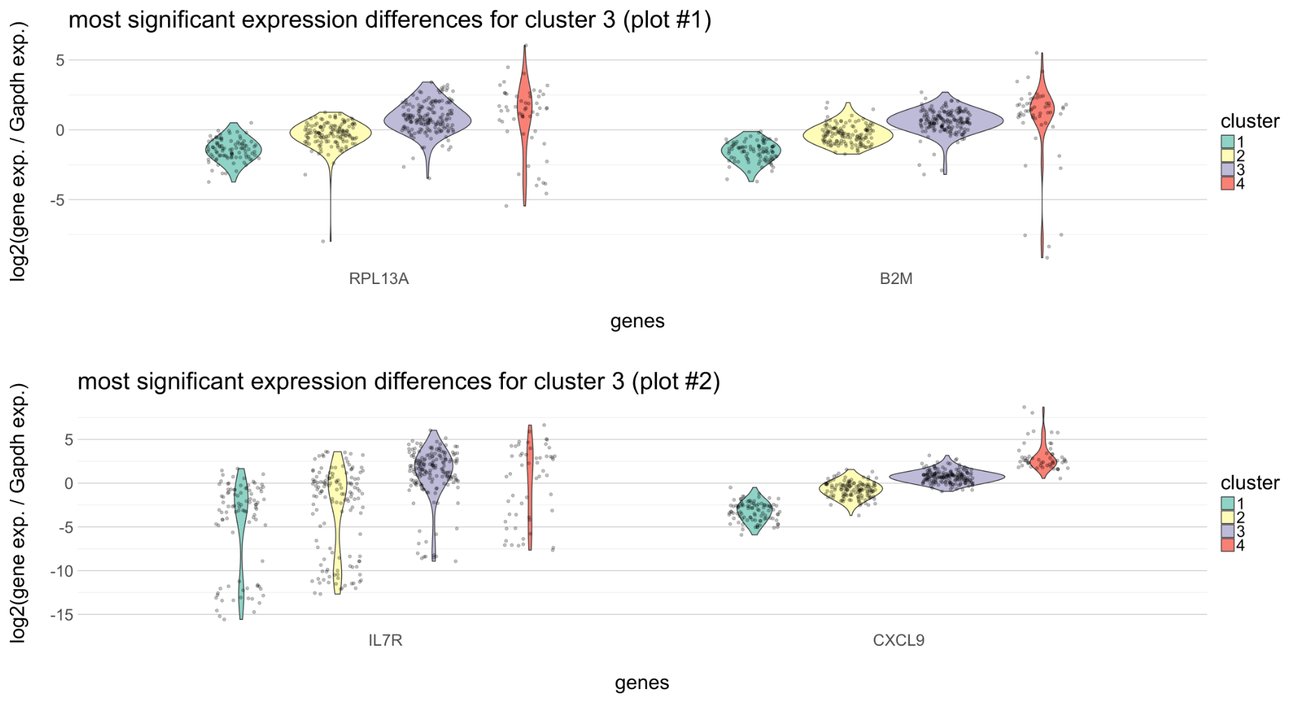

Slide 36


Slide 37



Unnormalized?

Slide 38

Strange patterns

Slide 39

Differences between children and adults

